Slide 1
User Needs and Requirements
Derek Brandt
Tyler Orman
Aryan Rao
Israel Sanchez Tellez

Slide 2
Agenda
Project Overview
User Needs
Requirements
Engineering Standards
Conclusion

Slide 3
Project Overview

Slide 4
Project Overview
DigiClips is striving to be a website that catalogs diverse media content
including news coverage, advertisements, radio broadcasts, and podcasts.
Our team’s primary objective centers on revitalizing
the administration portal which oversees
user and server status.

Slide 5
User Needs

Slide 6
User Needs
Easy to use controls
Logical layout of components
User statistics should be customizable
Server status should be easy to find
Information should be up-to-date

Slide 7
Requirements

Slide 8
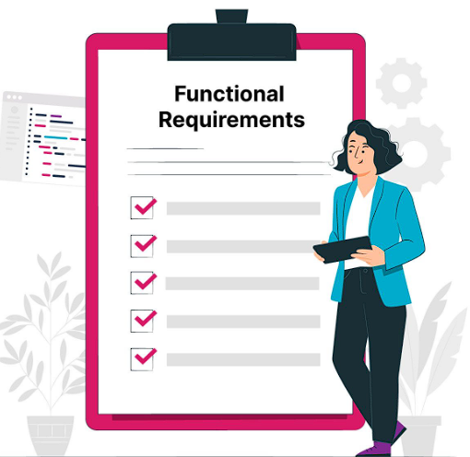
Functional Requirements
Website to provide fast results
Website needs to be fault tolerant for it to be accessed 24/7.
The administrator portal needs to gather backend machine analytics.
The administrator portal must show what subscribers and general users are searching for.

Slide 9
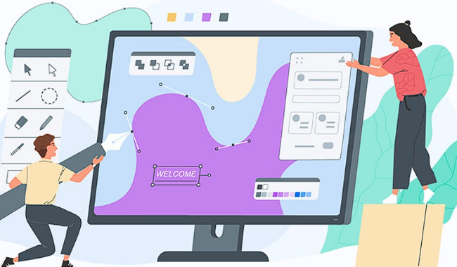
Aesthetic Requirements
Web page needs to be visually appealing to the potential clients.
Web Page layout should be logical, and the different elements should be easy to find.
All graphs need to be displayed with clear labels and titles.

Slide 10
Engineering Standards

Slide 11
IEEE 23026:2023
locating relevant and timely information
facilitating accessibility and ease of use
applying information security management
Engineering and management of websites for systems, software and services information

Slide 12
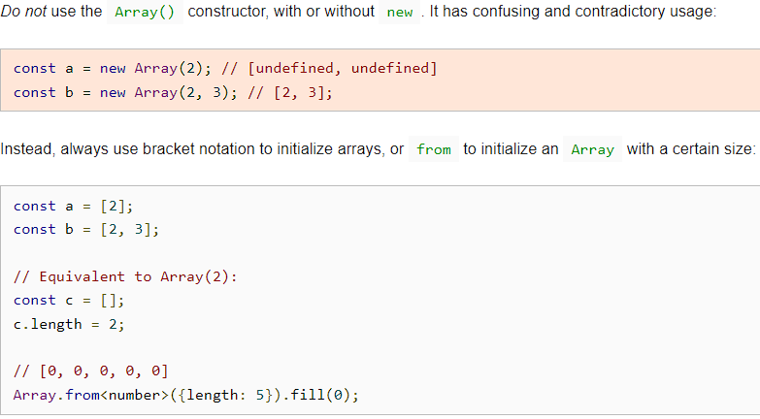
Angular Coding and Google TypeScript Style Guide
The team will also follow these Style Guides for current best coding practices.
If needed, current code may be refactored to current standards.

Slide 13
Conclusion

Slide 14
Conclusion
Using IEEE 23026 as reference and following current coding best practices, the team is undertaking the development of a new user experience.
With a focus on user needs, we aim to achieve both functional and aesthetic requirements, ensuring a professional solution.

